Slide 1
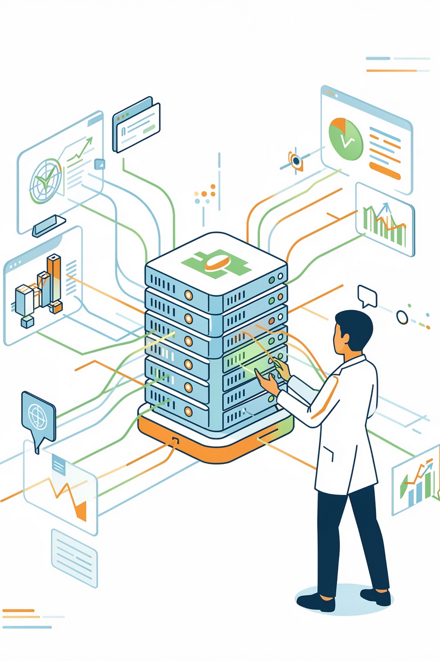
Healthcare Disease Prediction & Patient Analysis
Project-Based Learning Initiative | Semester 2

Slide 2

Project Objectives
Leveraging predictive analytics and machine learning to transform healthcare delivery and improve patient outcomes.
Early Diagnosis
Automate Hospital Tasks
Patient Monitoring & Reporting
Use predictive analytics to flag high-risk patients before symptoms appear. Machine learning models can identify diabetes or heart disease risk before onset, enabling timely preventive care.
Leverage ML to streamline routine processes like scheduling, alerts, and monitoring. Predictive forecasts of patient volume and staffing needs can significantly reduce delays.
Continuously track patient vitals and behaviors for proactive intervention. Data-driven alerts improve care quality and free staff for critical tasks.

Slide 3
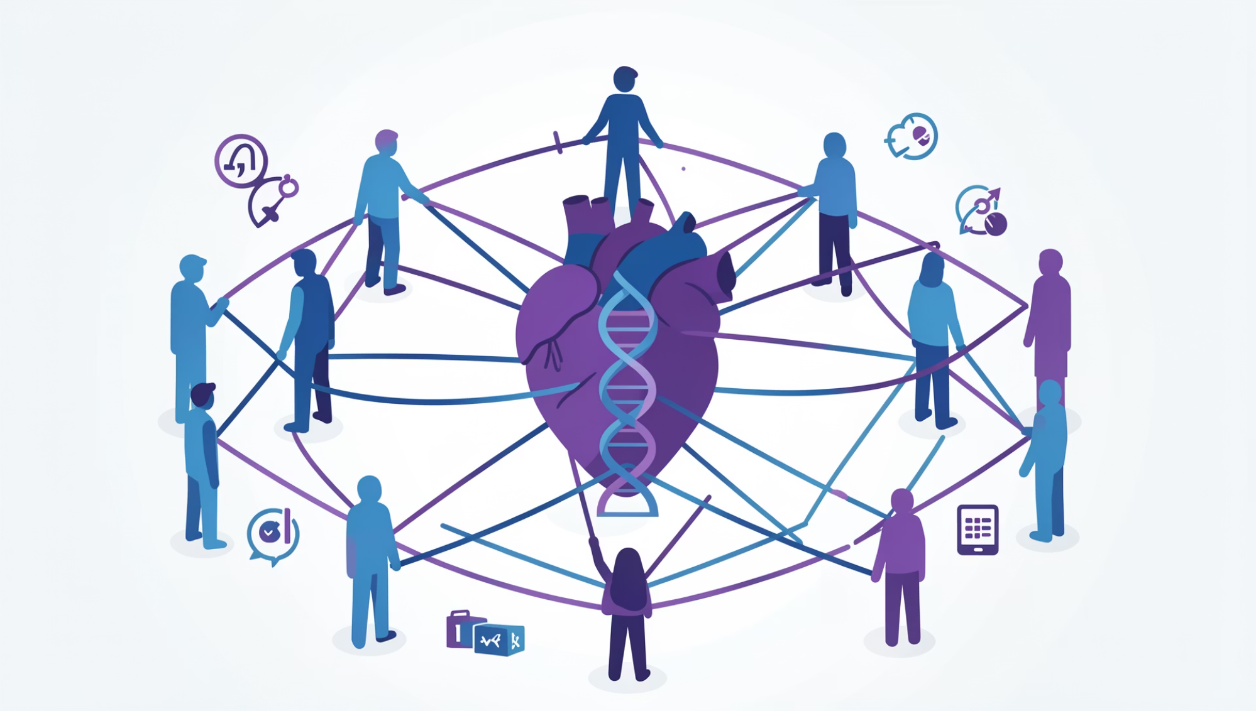
The Challenge: Lifestyle Disease Burden
Global Impact
Non-communicable (lifestyle) diseases including cardiovascular disease, diabetes, and obesity cause approximately 75% of global deaths (≈43 million in 2021).
~19 million deaths from cardiovascular disease annually
~2 million deaths from diabetes each year
Chronic conditions strain healthcare through hospitalizations and escalating costs
Growing Prevalence
Diabetes cases are surging globally—from 463 million adults in 2019, projected to reach 700 million by 2045. Managing complications burdens patients and healthcare systems.

Slide 4


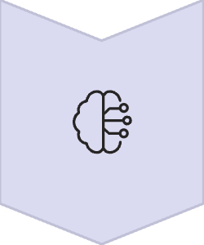


Project Pipeline: System Workflow
A comprehensive end-to-end system from data collection to actionable insights.
Data Collection
Gather patient records, sensor data, and lifestyle surveys
Data Management
Cleanse, normalize, and store in DBMS (SQL/NoSQL)
Feature Engineering
Select health features and train ML models using Python/R
Prediction & Alerts
Generate risk scores and integrate into hospital software
Reporting
Deliver dashboards and reports for clinicians and patients

Slide 5

Research Methodology
A mixed-methods approach combining human insights with data-driven analytics.
Qualitative Methods
Quantitative Methods
Conduct patient and provider surveys and interviews to capture lifestyle behaviors, medication adherence, and diet/exercise patterns.
Use statistical analysis and machine learning (Python/R) on historical health data. Train supervised learning models including regression and decision trees to predict disease risk.
This feedback informs model design and identifies relevant features for prediction.
Validate with metrics like accuracy and AUC-ROC.

Slide 6
Tools & Technologies Stack
Python Ecosystem
R Language
NumPy, Pandas, scikit-learn, TensorFlow for ML model development and deployment
Caret, ggplot2 for statistical analysis, visualization, model evaluation, and reporting
Databases
Cloud Platforms
SQL/NoSQL (MySQL, MongoDB) to store EHR data and patient history with secure access
AWS/GCP with HIPAA compliance for scalable storage and compute of big health data
Data Structures
ML Frameworks
Trees, graphs, k-d trees for similarity, priority queues for efficient scheduling
TensorFlow, scikit-learn for implementing supervised learning models

Slide 7

Application: Diabetes Risk Prediction
Real-World Impact
ML models identify individuals at high diabetes risk from factors including BMI, glucose levels, and family history.
463 million adults had diabetes in 2022, with projections reaching 700 million by 2045.
Predictive models can flag high-risk patients before symptoms develop, enabling preventive care and lifestyle interventions.
Clinical Value
Early identification allows healthcare providers to:
Implement preventive measures
Monitor high-risk patients closely
Reduce complications through early intervention
Improve patient outcomes

Slide 8

Application: Heart Disease Prediction
Wearable Integration
Wearable device data including blood pressure and ECG combined with AI can predict cardiovascular risk
Deep Learning Models
Recent research (January 2025) proposed deep learning models detecting hypertension anomalies from wearables, improving early CVD warnings
Early Detection
ML can detect heart-related issues earlier than traditional methods, enabling timely medical intervention

Slide 9
Skills Mapping: Academic Subjects in Practice
Subject
Application in Healthcare Analytics
Python
Data wrangling, ML model coding (scikit-learn, TensorFlow), algorithm implementation, and system integration
R
Statistical analysis, visualization (ggplot2), model evaluation, and generating clinical reports
DSA
Efficient algorithms for data processing (search/sort), tree structures for decision models, and performance optimization
DBMS
Design and manage patient database (SQL schema, NoSQL collections), query design for quick retrieval, ensure ACID compliance and security
Mathematics
Probability, statistics, linear algebra for model fundamentals (regression, classification), risk score calculations, and evaluation metrics (ROC, precision/recall)

Slide 10
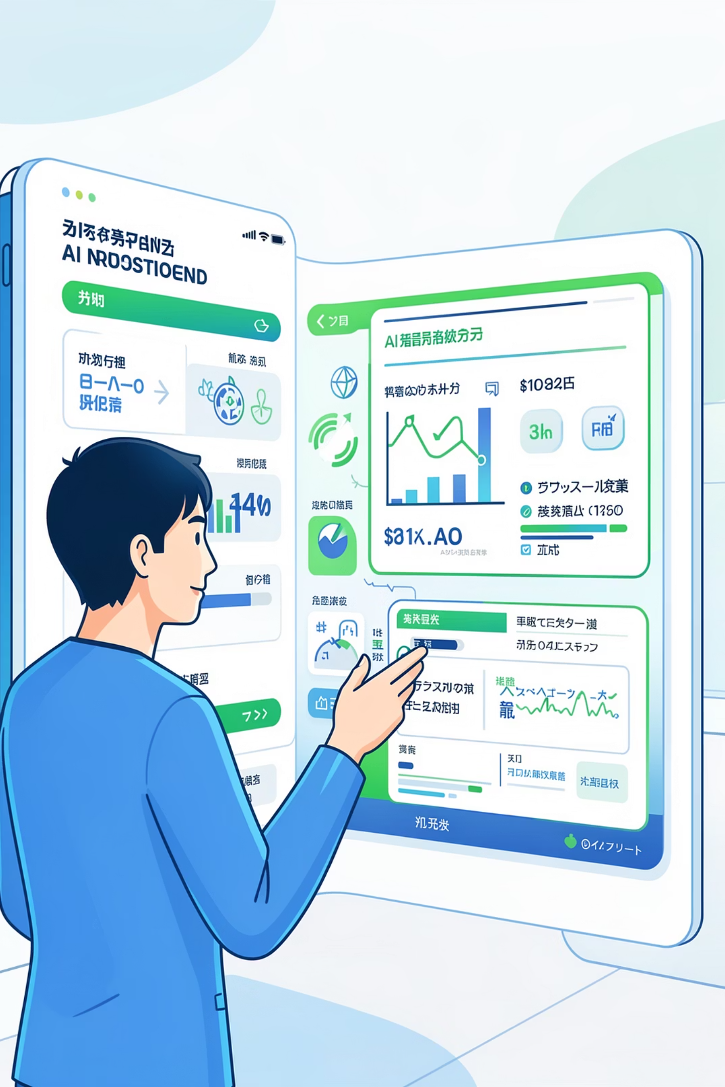
Conclusion & Future Vision
Project Summary
Our PBL system empowers early disease detection and operational efficiency. By leveraging predictive analytics, it supports proactive care and automates routine tasks, improving patient outcomes.
Near-Term Future
Integrate wearables and IoT for real-time monitoring including continuous blood pressure and glucose tracking. AI-powered remote monitoring is growing rapidly.
Population Health
Scale from individual care to population health—health systems and governments already use predictive models to forecast public health trends and allocate resources.
Long-Term Vision
Evolve into a comprehensive AI health assistant integrating genomics, medical imaging, and big data for personalized, preventive healthcare.

